Slide 1
Semester project presentation
1. Introduction
Extending Dynamic Structure in Memory Network for Response Generation
Supervisor: Mi Fei
Director: Prof .Boi Faltings
Myself: André Cibils
Plan:
1. Introduction
2. Modifications
3. Results
4. Further Modifications
5. Questions
Extending Dynamic Structure in Memory Network for Response Generation
Notes:
So today...

Slide 2
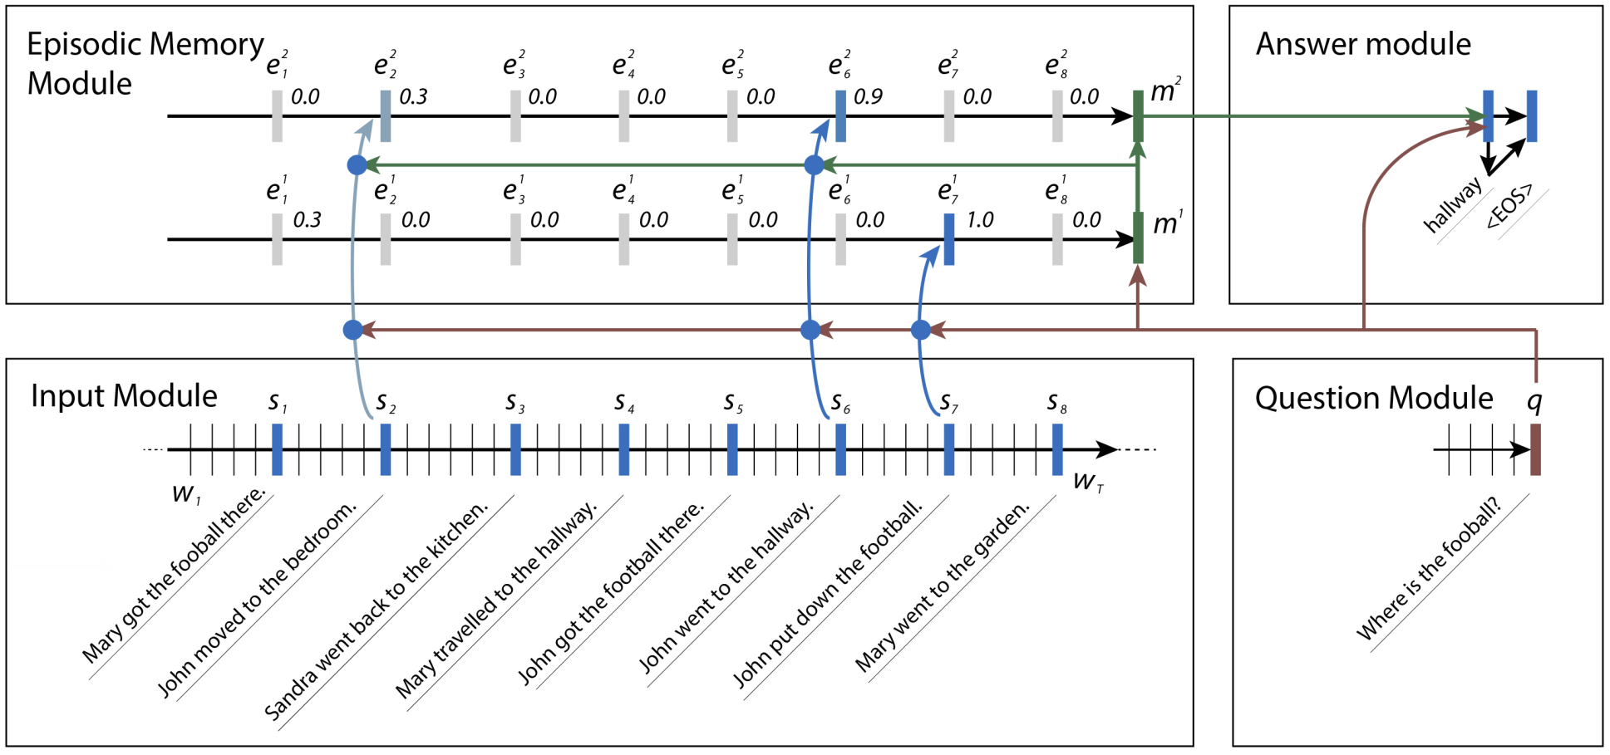
DMN – quickly
1. Introduction
Notes:
Main idea:
-Use lot of GRU
-Incode sentences with input module
-Incode question with question module
-In Episodic Memory Module:
-Attention Mechanism to highlight important part of input
-Memory Update Mechanism to produce memory
-Answer module to decode memory

Slide 3
DMN - Modification
2. Modifications
Modification of the answer module.
Now can produce (fixed & limited) number of words.
Iterate with a GRU (Gated Recurent Unit) with the last memory as input, as in the recurrent encoder-decoder generator.
Notes:
Loss calculation is obviously modified as well
We can learn the model to produce <eos> char, so having a fixed nbr of words is not a problem

Slide 4
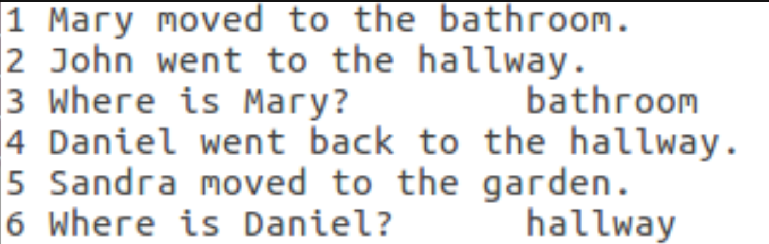
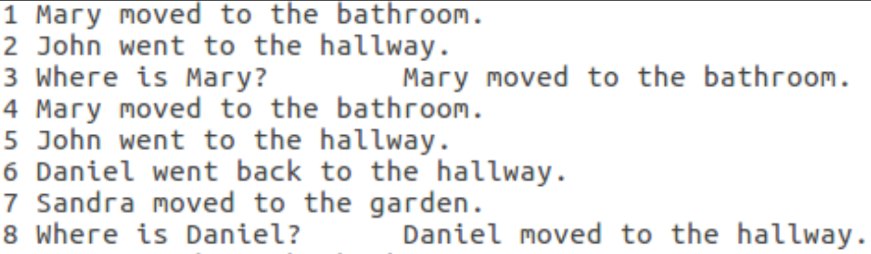
Dataset – First Modifications
2. Modifications
Notes:
Basic modification of the answers only

Slide 5
Dataset – First Modifications
2. Modifications
Notes:
Basic modification of the answers only

Slide 6
Dataset – First Modifications
2. Modifications
Main idea is to give the model precise and easy to learn sentences.
Always the same architecture.
Poor, but easy to produce and test.
<Subject> went to the <Place>. (ex: "Marie went to the office.")
Subject is really easy: it's in the question "Where is Marie?"
Place is way harder to get, but we know that the model can learn it with enough training.
Notes:
Easy to "overfit" over the fixed part: right now, not an issue
We want to see if the model can understant where to put each word
If yes, we can probably train it to make it understant where to put each word
Obv, it'll always produce sentences architecture it has already seen
We don't tell it the rules to produce a sentence (i.e. 3Th person singular + .s)

Slide 7
Dataset – First Modifications
2. Modifications
Main idea is to give the model precise and easy to learn sentences.
Always the same architecture.
Poor, but easy to produce and test.
<Subject> went to the <Place>. (ex: "Marie went to the office.")
Subject is really easy: it's in the question "Where is Marie?"
Place is way harder to get, but we know that the model can learn it with enough training.
Notes:
Easy to "overfit" over the fixed part: right now, not an issue
We want to see if the model can understant where to put each word
If yes, we can probably train it to make it understant where to put each word
Obv, it'll always produce sentences architecture it has already seen
We don't tell it the rules to produce a sentence (i.e. 3Th person singular + .s)

Slide 8
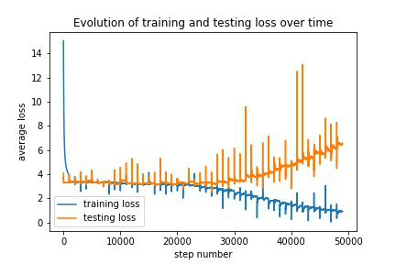
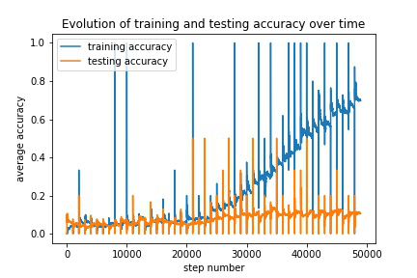
Dataset – Results
3. Results
With a small dataset, results are not that good.
if the model gets the answer perfectly, accuracy is set to 1, else to 0.
Notes:
(explain the data!)
It takes some time! For a simple task like this one.
Overfitting occurs. This is trained with 1000 example, but there is more data availabe
Accuracy is =1 if the model is completly right, else it is 0: hard mesure
Hopefully the big dataset will get better results

Slide 9
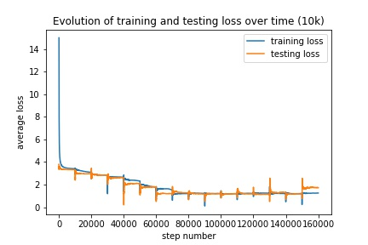
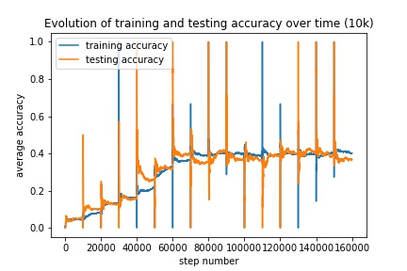
Dataset – Results
3. Results
With a big dataset, results seems better.
Notes:
It takes a lot of time! For a simple task like this one.
Here, no overfitting occurs yet. I suspect that if the model runs for too long, overfitting will occur.
Results are better but not good (40% acc, 100% on base))
The goal is to try with an even bigger dataset to see if the average accuracy still improve (memory issue though)
I need to think of possible modification of the model as well

Slide 10

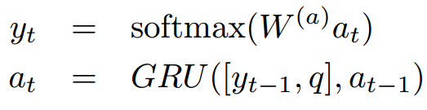
Why does it take so much data?
3. Results
Depending on the task, a lot of iteration on the memory.
A lot of modifications are applied.
Notes:
Mtm is the last memory vector produced by the memory update mechanism
Q is the question
W(a) are some learned parameters
I can force it easly (introducing a different memory vector for the last word specificly for exemple) but
If I do so, I'll lose the idea itself of not telling the model how to produce it sentence
With time (and enough exemple..!) the model learn to produce the right word

Slide 11
Dataset – Complex Modifications
4. Further Modifications
The biggest issues right now are the dataset & the model.
The goal is to modify the dataset in order to have more complex sentences with higher number of degree of liberty.
The <Object> was in the <Place> before being in the <Place>.
  (Where was the football before the bathroom?
  The football was in the office before being in the bathroom.)
Notes:
Iteratively complexify the dataset (here, more degree of liberty and more words (11 versus 5)) to see the evolution of the performance
Overfitting occured, with a small dataset, loss = 0.0 on the training set but high on the testset

Slide 12
Dataset – Complex Modifications
4. Further Modifications
Goal is to find, or more likely produce, more complex dataset with more degree of liberty
<Subject> <Verb> the <Noun>
She ate the fish
They found the key
At the end, we would like to have dataset with multiple sentences and without architecture at all
Notes:
No idea if this will work
Hopefully it will
If not, I'll probably thinks about different modifications of the DMN
No dataset like this exist I think
I'll try to produce one if I have enough time, this is the hardest part now with the potential model modification

Slide 13
Questions?
5. Questions

